Slide 1

Welcome to New York
Azure Certification Jump Start 70-475 Designing and Implementing Big Data Analytics Solutions
Content Location:
https://github.com/guruskill/70-475
Notes:
Greetings all and Welcome To New York City,
I am Dan Stolts, I will be your MC for the day. We have two rooms here in NYC so speakers are splitting their time between the two
We are thrilled to have you join us for this important topic. We hope to be able to do more of these shows in the future. I would like to encourage you to go back to your organizations and teach others some of what you learned. If others in your organization would like a similar event, please have them contact your Microsoft Account Team.
Let’s start things off with a

Slide 2
Executive Welcome!
Please Welcome
Laura Clayton McDonnell

Slide 3
Please Socialize! #70-534 @ITProGuru
Please tell the world about what is going on here this week.
What you like
What you learned ☺ every time you learn something new ☺
How this knowledge can be leveraged at work

Slide 4
Voting: Show of Hands
How deep is your knowledge of Azure Cloud Solutions?
1. I know Azure and its offerings really well
2. I know some of Azure
3. I’m just getting started with Azure

Slide 5
Voting: Show of Hands
Are you planning on taking the Azure Certification Exam related to this content?
1. Yes
2. Maybe, I’m interested in finding out more
3. No, please elaborate?

Slide 6
Voting: Show of Hands
Do you feel you are educationally ready to deliver Azure Solutions?
1. Yes, Ready to go
2. Maybe, after doing homework, I will be ready
3. No, please elaborate?

Slide 7
Voting: Show of Hands
Do you have ability and subscription access to practice what you learned; to continue to growing your skills in Azure?
Yes
No
Explain

Slide 8
Exam 70-534 Architecting Microsoft Azure Solutions
#1 Design Azure Resource Manager (ARM) networking (5–10%)
Design Azure virtual networks - Extend on-premises
Describe Azure VPN and Express Route architecture and design
#2 Secure resources (20–25%)
Secure resources by using managed identities
Secure resources by using managed identities
Secure resources by using identity providers
Identify an appropriate data security solution
Design a role-based access control (RBAC) strategy
Manage security risks by using an appropriate security solution
#3 Design an application storage and data access strategy (5–10%)
Design data storage
Select the appropriate storage option
#4 Design advanced applications (20–25%)
Create compute-intensive applications
Create long-running applications
Integrate Azure services in a solution
Implement messaging applications
Implement applications for background processing
Design connectivity for hybrid applications
#5 Design Azure Web and Mobile Apps (5–10%)
Design Web Applications
Design Mobile Applications
#6 Design a management, monitoring, and business continuity strategy (20–25%)
Design a monitoring strategy
Describe Azure business continuity/disaster recovery (BC/DR) capabilities
Design a disaster recovery strategy
Design Azure Automation and PowerShell workflows
Describe the use cases for Azure Automation configuration
#7 Architect an Azure Compute infrastructure (10–15%)
Design ARM Virtual Machines (VMs)
Design ARM template deployment
Design for availability
+ Bonus: Containers
https://www.microsoft.com/learning/en-us/exam-70-534.aspx
Notes:
We have 7 primary sections called Objective Domains (OD) to cover. Each one has sub categories. Each has a percentage range. This percentage is the value of that portion on the exam. Note, some are 5-10 while others are 20-25. The sections that are 20-25 means that up to 25% of the points you can get on the exam will be in the topic area. You can see additional information on each section at the link on the bottom of the page.

Slide 9
Questions Post Event…
Yammer Group – Microsoft Azure Certification Preparation
http://aka.ms/AzureExamPrep
Notes:
Exam tips are slides to pay close attention to. You will very likely see many questions that are related to the various Exam Tips.
This Yammer Group will NOT be on the exam. We just wanted to highlight it is very important so you know where to turn after the event is finished.

Slide 10
Important Technology Cert program
Cloud focused
Many exams focus on cloud-based technologies
When relevant, hybrid environments are part of solutions
Constant Updates
Exams are continuously updated to reflect changes in the cloud
Exam are updated every several months
New Exam Releases
Many new exams released in FY17 and FY18, focusing on cloud platforms, data science, and many new product releases.

Slide 11
Exam Basics
40-60 questions
1-3 hours to complete the exam
Can review questions (for most question types)
Can include up to 20 different types of questions
700 is passing
700 <> 70%

Slide 12
Who should take this exam?
This certification exam is targeted towards data management professionals, data architects, data scientists, and data developers who design big data analytics solutions on Microsoft Azure. Candidates for this exam will have relevant work experience in big data analytics solutions.

Slide 13
Design big data batch processing and interactive solutions (30–35%)
Ingest data for batch and interactive processing
Ingest from cloud-born or on-premises data, store data in Microsoft Azure Data Lake, store data in Azure BLOB Storage, perform a one-time bulk data transfer, perform routine small writes on a continuous basis
Design and provision compute clusters
Select compute cluster type, estimate cluster size based on workload
Design for data security
Protect personally identifiable information (PII) data in Azure, encrypt and mask data, implement role-based security, implement row-based security
Design for batch processing
Select appropriate language and tool, identify formats, define metadata, configure output

Slide 14
Design big data real-time processing solutions (30–35%)
Ingest data for real-time processing
Select data ingestion technology, design partitioning scheme, design row key of event tables in HBase
Design and provision compute resources
Select streaming technology in Azure, select real-time event processing technology, select real-time event storage technology, select streaming units, configure cluster size, select the right technology for business requirements, assign appropriate resources for HBase clusters
Design for Lambda architecture
Identify application of Lambda architecture, utilize streaming data to draw business insights in real time, utilize streaming data to show trends in data in real time, utilize streaming data and convert into batch data to get historical view, design such that batch data doesn’t introduce latency, utilize batch data for deeper data analysis
Design for real-time processing
Design for latency and throughput, design reference data streams, design business logic, design visualization output

Slide 15
Operationalize end-to-end cloud analytics solutions (30–35%)
Create a data factory
Identify data sources, identify and provision data processing infrastructure, utilize Visual Studio to design and deploy pipelines, deploy Data Factory Jobs
Orchestrate data processing activities in a data-driven workflow
Leverage data-slicing concepts, identify data dependencies and chaining multiple activities, model complex schedules based on data dependencies, provision and run data pipelines
Monitor and manage the data factory
Identify failures and root causes, create alerts for specified conditions, perform a restatement, start and stop data factory pipelines
Move, transform, and analyze data
Leverage Pig, Hive, MapReduce for data processing; copy data between on-premises and cloud; copy data between cloud data sources; leverage stored procedures; leverage Machine Learning batch execution for scoring, retraining, and update resource; extend the data factory with custom processing steps; load data into a relational store, visualize using Power BI
Design a deployment strategy for an end-to-end solution
Leverage PowerShell for deployment, automate deployment programmatically, design deployment strategies for automation

Slide 16
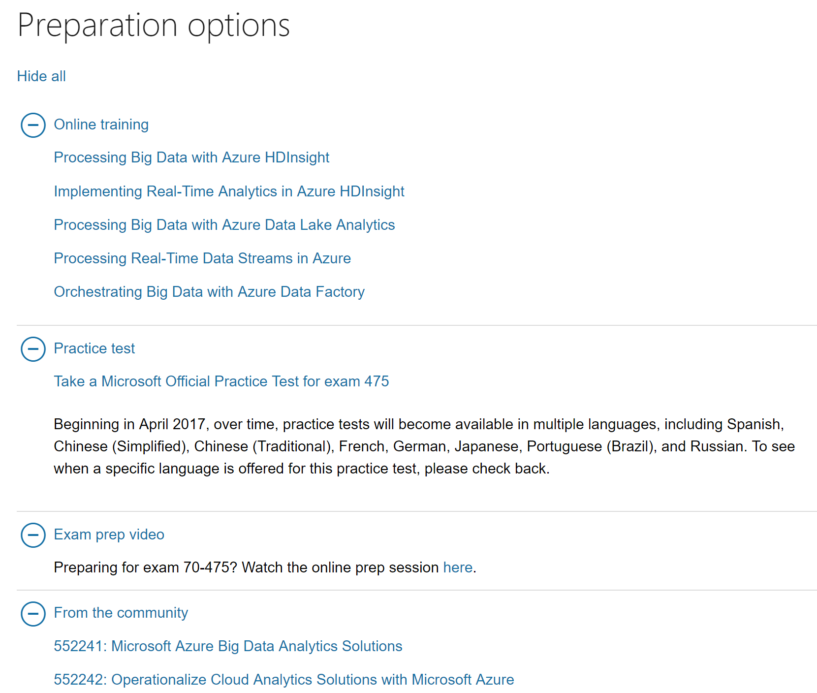

Slide 17
Microsoft Certified Solutions Associate
Background
A specialist who knows “how” to work with an advanced product
For those with access to hands-on practical experience.
Someone with 1-2 years’ experience
Simplified Tracks
Requires passing 2 exams
Only one more exam to reach MCSE (Microsoft Certified Solutions Expert)
MCSA certification is required in order to become an MCSE.

Slide 18
MOBILITY
MCSE Mobility
Earned: 2017
MCSA Windows 10
Elective
MCSA Windows
Server 2012
MCSA Windows Server 2016
MCSE Cloud Platform & Infrastructure
Earned: 2017
CLOUD PLATFORM & INFRASTRUCTURE
Elective
MCSA Linux on
Azure
MCSA Cloud Platform
PRODUCTIVITY
MCSA Windows Server 2012 or 2016
MCSE
Productivity Earned: 2017
Elective
MCSA Office 365
MCSA SQL Server 2012/2014
DATA MANAGEMENT & ANALYTICS
MCSA SQL 2016
Database Dev
MCSE
Data Mgmt & Analytics Earned: 2017
Elective
MCSA SQL 2016
Database Admin
MCSA SQL 2016
BI Development
MCSA Machine Learning
APP BUILDER
MCSA Web Applications
MCSD
App Builder Earned: 2017
Elective
MCSA Universal Windows Platform
BUSINESS APPLICATIONS
MCSA Dynamics 365
MCSE
Business Applications
Earned 2017
Elective
MCSA Dynamics 365 For Operations

Slide 19
CLOUD PLATFORM & INFRASTRUCTURE PATH
410:
Installing and Configuring
Windows Server 2012
411:
Administering
Windows Server 2012
412:
Configuring Advanced
Windows Server 2012
Services
MCSA Windows
Server 2012
740:
Installation, Storage, and
Compute with
Windows Server 2016
741:
Networking with
Windows Server 2016
742:
Identity with
Windows Server 2016
MCSA Windows Server 2016
CLOUD PLATFORM & INFRASTRUCTURE
MCSE Cloud Platform & Infrastructure
Earned: 2017
Elective
533: Managing
Microsoft Azure
Infrastructure Solutions
LFCS:
Linux Foundation
Certified System Administrator
MCSA Linux on
Azure
Elective Exam Pool
532: Developing Microsoft Azure Solutions
533: Managing Microsoft Azure Infrastructure Solutions
534: Architecting Microsoft Azure Solutions
473: Designing and Implementing Cloud Data Platform Solutions
475: Designing and Implementing Big Data Analytics Solutions
744: Securing Windows Server 2016
413: Designing and Implementing a Server Infrastructure
414: Implementing an Advanced Server Infrastructure
246: Monitoring and Operating a Private Cloud
247: Configuring and Deploying a Private Cloud
Choose two from:
532: Developing Microsoft Azure Solutions
533: Managing Microsoft Azure Infrastructure Solutions
534: Architecting Microsoft Azure Solutions
473: Designing and Implementing Cloud Data Platform Solutions
475: Designing and Implementing Big Data Analytics Solutions
MCSA Cloud Platform

Slide 20
DATA MANAGEMENT & ANALYTICS PATH
461: Querying Microsoft
SQL Server 2012/2014
462: Administering
Microsoft SQL Server
2012/2014 Databases
463: Implementing a
Data Warehouse with
Microsoft SQL Server
2012/2014
MCSA SQL Server
2012/2014
761: Querying Data
with Transact-SQL
762: Developing
SQL Databases
MCSA SQL 2016
Database Dev
MCSE
Data Mgmt & Analytics Earned: 2017
DATA MGMT & ANALYTICS
Available: Now
Elective
764: Administering a SQL
Database Infrastructure
765: Provisioning
SQL Databases
MCSA SQL 2016
Database Admin
Elective Exam Pool
473: Designing and Implementing Cloud Data Platform Solutions
475: Designing and Implementing Big Data Analytics Solutions
464: Developing Microsoft SQL Server Databases
465: Designing Database Solutions for SQL Server
466: Implementing Data Models and Reports with Microsoft SQL Server
467: Designing Business Intelligence Solutions with Microsoft SQL Server
773: Analyzing Big Data with Microsoft R
774: Perform Cloud Data Science with Azure Machine Learning
775: Perform Data Engineering on Microsoft Azure HDInsight
778: Analyzing and Visualizing Data with Microsoft Power BI (beta)
767: Implementing a
SQL Data Warehouse
768: Developing
SQL Data Models
MCSA SQL 2016
BI Development
773: Analyzing Big Data
with Microsoft R (new)
774: Perform Cloud Data Science
with Azure Machine Learning (new)
MCSA Machine Learning
778: Analyzing and
Visualizing Data with
Microsoft Power BI (beta) or
779: Analyzing and Visualizing Data with Microsoft Excel (beta)
Upcoming Paths
768: Developing
SQL Data Models
MCSA SQL BI
Reporting
775: Perform Data
Engineering on Microsoft
HD Insight (new)
776: Perform Big Data Engineering on
Microsoft Cloud Services (beta)
MCSA Data
Engineering with Azure
777: Implementing NoSQL
Solutions with DocumentDB
and Azure Search (Planned)
473: Designing and Implementing Cloud
Data Platform Solutions
MCSA Azure Database
Development

Slide 21
Microsoft Professional Program for Big Data
Unit 1: Data Fundamentals
Unit 2: Big Data Processing
Unit 3: Big Data Solutions
Unit 4: Project
Validated Skills
Analyze and Visualize Data
Work With NoSQL Data
Query Relational Data
Create a Data Warehouse
Process Big Data at Rest
Process Big Data in Motion
Orchestrate Big Data Solutions
Build Big Data Analysis Solutions
Developing Big Data Solutions with Azure Machine Learning
Analyzing and Visualizing Data with Excel
Processing Big Data with Azure Data Lake Analytics
Processing Real-Time Data Streams in Azure
Course Options
Big Data Orientation
Introduction to NoSQL Data Solutions
Querying Data with Transact-SQL
Delivering a Data Warehouse in the Cloud
Orchestrating Big Data with Azure Data Factory
Analyzing Big Data with Microsoft R Server
Capstone Project
Analyzing and Visualizing Data with Power BI
Processing Big Data with Hadoop in Azure HDInsight
Implementing Real-Time Analytics with Azure HDInsight
Implementing Predictive Solutions with Spark in HDInsight
https://academy.microsoft.com/en-us/professional-program/tracks/big-data/

Slide 22
Azure Account
You will need a Microsoft Azure account
You can use a production Azure account if you are able to create objects
You can also use your Microsoft Developer Network (MSDN) account (if you have one) to complete this workshop
If you don’t have access to a corporate or MSDN account: Create a free account using this process (http://azure.microsoft.com/free)

Slide 23
Free Azure Subscription
$200 credit for 30 days
Specific quantities of some services (including B1S VM) are offered free for 12 months now
“Free Services” page provides clear buttons to avoid inadvertent launch of non-free services
Cost management makes it easy to see how you’re doing at any given point
Solid assortment of always-free services
Use credit card only to verify your identity and don't charge your credit card unless you convert to a PAYG subscription
Get started: https://azure.microsoft.com/en-us/free/
https://channel9.msdn.com/Shows/Azure-Friday/Azure-Free-Account

Slide 24
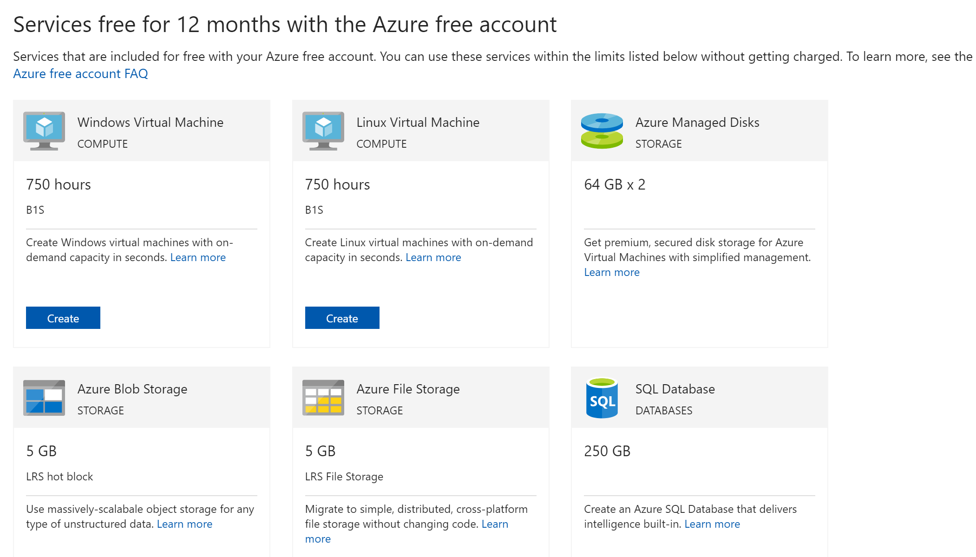
https://azure.microsoft.com/en-us/free/free-account-faq/

Slide 25
